Slide 1
Data Exploration
Dr. Vijayalakshmi Anand
BITS-Pilani

Slide 2
Data exploration
What is data exploration
Types of data set
Types of attribute
Basic Statistical Descriptions of Data
Data similarities and dissimilarities

Slide 3
What is Data Exploration?
Data exploration involves summarizing the main characteristics of a dataset
Motivation :
Right tool for pre-processing or analysis.
Recognize the patterns
Outlier detection

Slide 4
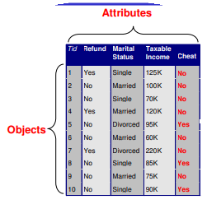
What is data?
Collection of data objects and their attributes
An attribute is a property or characteristic of an object
– Examples: eye color of a person, temperature, etc.
Attribute is also known as variable, field, characteristic, or feature
– A collection of attributes describe an object
– Object is also known as record, sample, entity, or instance

Slide 5
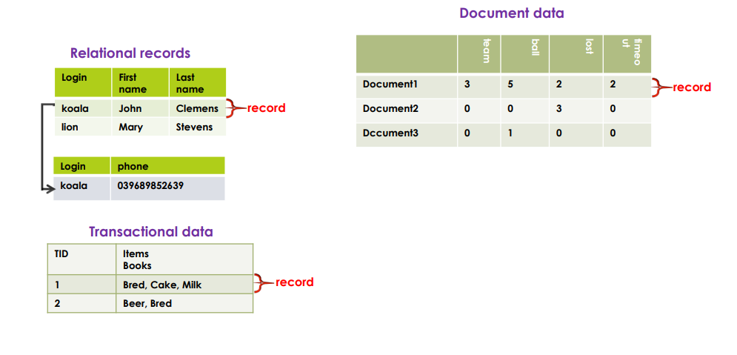
Types of Data Sets
Record
Transaction data
Data matrix
Document data

Slide 6
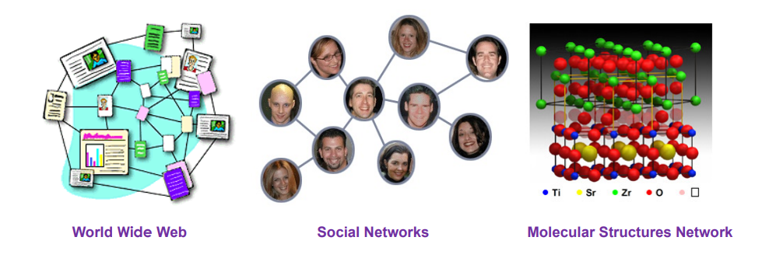
Graph and network
World Wide Web
Social or information networks
Molecular Structures

Slide 7

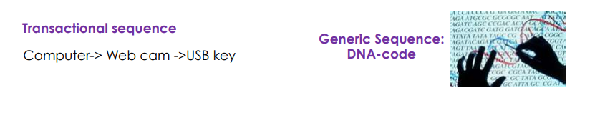
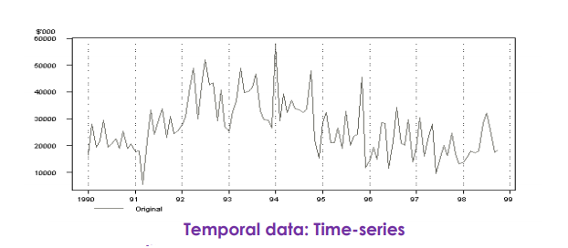
Ordered
Videos
Temporal data
Genetic sequence data

Slide 8
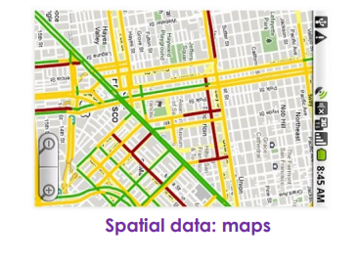



Spatial, image and multimedia
Spatial data
Image data
Video data
Audio Data

Slide 9
Important Characteristics of Datasets
Dimensionality
Curse of dimensionality
Sparsity
Only presence counts
Resolution
Patterns depend on the scale
Distribution
Centrality and dispersion

Slide 10
Attributes
Attribute :a representing a characteristic or feature of a data object.
E.g., customer _ID, name, address
Types:
Qualitative
Nominal
Binary
Quantitative
Numeric
Interval-scaled
Ratio-scaled

Slide 11
Nominal attributes
Nominal Attributes
– related to names
– categorical attributes
Eg:
Hair_color = { black, blond, brown, grey, red, white},marital status, occupation, ID numbers, zip codes

Slide 12
Attribute Types
Binary
only 2 states (0 and 1)
Symmetric binary: both outcomes equally important
e.g., gender
Asymmetric binary: outcomes not equally important.
e.g., medical test (positive vs. negative)
Ordinal
Values have a meaningful order (ranking)
Size = {small, medium, large}, grades, army rankings

Slide 13
Attribute Types –Numeric attributes
Interval
Difference between 2 variables
Values have order
E.g., temperature in C˚or F˚, calendar dates
Ratio
Equal and definite ratio between the data E.g.,Height and Weight

Slide 14
Attribute Types
Discrete Attribute
Has only a finite or countably infinite set of values
E.g. hair_color,customer id ,zipcode
Sometimes, represented as integer variables
Continuous Attribute
Has real numbers as attribute values
E.g., temperature, height, or weight
Practically, real values can only be measured and represented using a finite number of digits
Continuous attributes are typically represented as floating-point variables

Slide 15
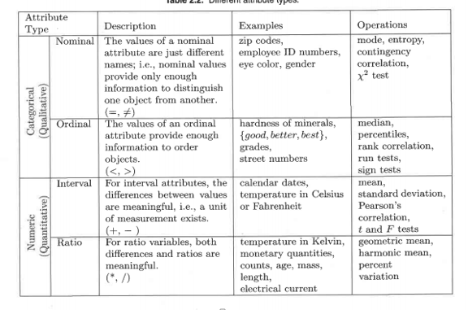

Slide 16
Basic Statistical Descriptions of Data

Slide 17
Basic Statistical Descriptions of Data
Motivation
To better understand the data: central tendency, variation and spread
Data dispersion characteristics
median, max, min, quantiles, outliers, variance, etc.

Slide 18
Measuring the Central Tendency
Mean (algebraic measure) (sample vs. population):
the mean is very sensitive to outliers
--arithmetic mean:
Trimmed mean: chopping extreme values
Median:
Middle value if odd number of values, or average of the middle two values otherwise
Mode
Value that occurs most frequently in the data
54, 54, 54, 55, 56, 57, 57, 58, 58, 60, 60
Unimodal, bimodal
Age | Frequency
54 | 3
55 | 1
56 | 1
57 | 2
58 | 2
60 | 2

Slide 19
Example Mean and Median
Find the mean, median, mode for the following list of values:
13, 18, 13, 14, 13, 16, 14, 21, 13
The mean is the usual average,
(13 + 18 + 13 + 14 + 13 + 16 + 14 + 21 + 13) ÷ 9 = 15
The median is the middle value, so rewrite the list in numerical order:
13, 13, 13, 13, 14, 14, 16, 18, 21
There are nine numbers in the list, so the middle one will be the 5th number
Mode?

Slide 20
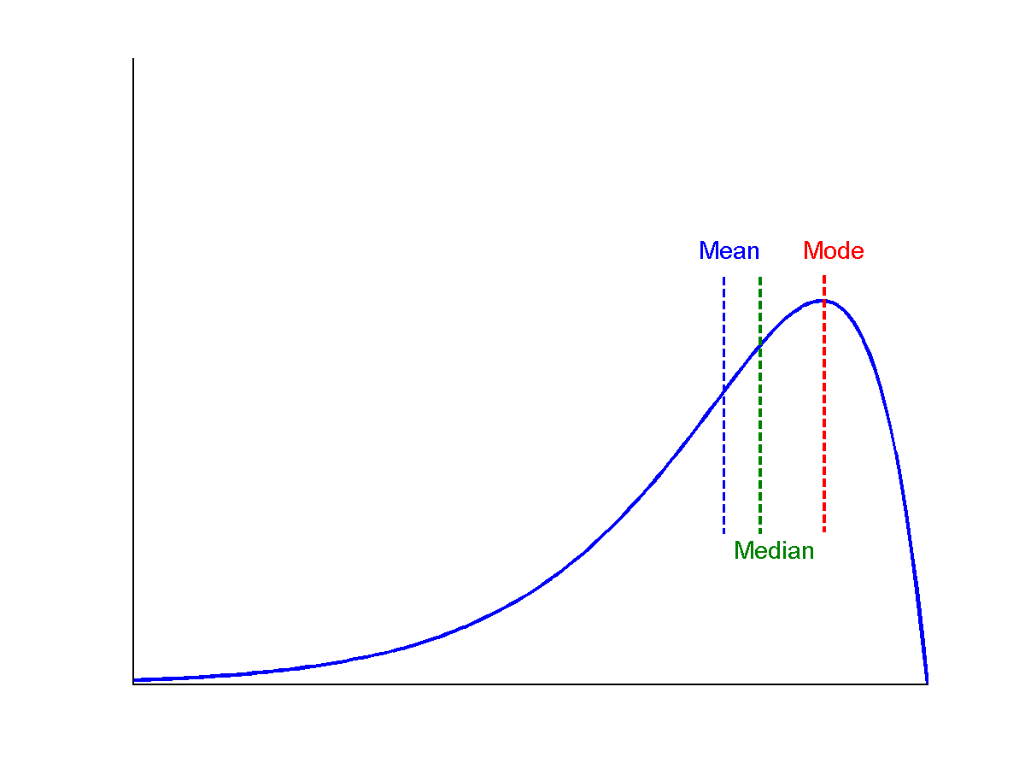
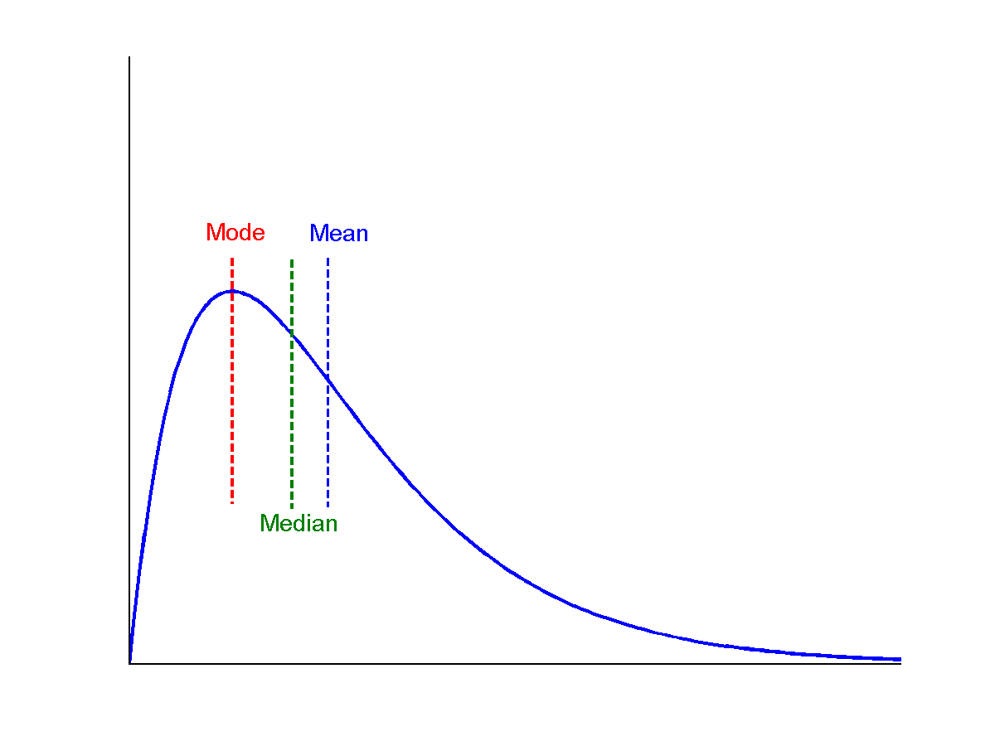
Symmetric vs. Skewed Data
Median, mean and mode of symmetric, positively and negatively skewed data
symmetric
negatively skewed
positively skewed

Slide 21
Effect of Skewness
Outlier detection
Eg: consider the retirement dataset
54, 54, 54, 55, 56, 57, 57, 58, 58, 60, 81 Mean=58.5
Median=57

Slide 22
Measuring the Dispersion of Data
Is used to describe the variability in a sample or population
A measure of dispersion is also called a measure of spread /scattering of the data.
It is usually used in conjunction with a measure of central tendency such as the mean or median, to provide an overall description of a set of data

Slide 23
Five number summary
The minimum – this is the smallest value in our data set.
The first quartile – this number is denoted Q₁ and 25% of our data falls below the first quartile.
The median – this is the midway point of the data. 50% of all data falls below the median.
The third quartile – this number is denoted Q₃ and 75% of our data falls below the third quartile.
The maximum – this is the largest value in our data set.

Slide 24
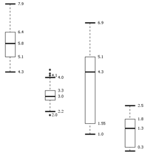
Measuring the Dispersion of Data
Boxplot:
graphic display of five-number summary
Data is represented with a box
The ends of the box are at the first and third quartiles, i.e., the height of the box is IQR
The median is marked by a line within the box
Whiskers: two lines outside the box extended to Minimum and Maximum
Outliers: points beyond a specified outlier threshold, plotted individually

Slide 25


Variance and standard deviation
Variance and standard deviation (sample: s, population: σ)
Variance: (algebraic, scalable computation)
Standard deviation s (or σ) is the square root of variance s² ⁽or σ²⁾

Slide 26
Example
Following is an ordered list of observations of a variable. Compute 5 point summary.
13, 15, 16, 16, 19, 20, 20, 21, 22, 22, 25, 25, 25, 25, 30, 33, 33, 35, 35, 35, 35, 36, 40, 45, 46, 52, 70
Solution:
Min: 13
Q1: 20
Median: 25
Q3: 35
Max: 70
IQR=Q3-Q1=15

Slide 27
Summary Basic statistical description
Provide the analytical foundation for data preprocessing. The basic statistical measures for data summarization include mean, weighted mean, median, and mode for measuring the central tendency of data; quantiles, quartiles, interquartile range, variance, and standard deviation for measuring the dispersion of data

Slide 28
Data similarities and dissimilarities

Slide 29
Data similarities and dissimilarities
Similarity
Numerical measure of how alike two data objects are
Value is higher when objects are more alike
Often falls in the range [0,1]
Dissimilarity (e.g., distance)
Numerical measure of how different two data objects are
Lower when objects are more alike
Minimum dissimilarity is often 0
Upper limit varies
Proximity refers to a similarity or dissimilarity

Slide 30
Data Matrix versus Dissimilarity Matrix
Data matrix
n data points (rows) with p dimensions (attributes or columns)
A data matrix is Two modes as, made up of two entities or “things,” namely rows (for objects) and columns (for attributes)
Dissimilarity matrix
This structure stores a collection of proximities that are available for all pairs of n objects
n data points, but registers only the distance
A triangular matrix
Single mode as it contains one kind of entity (dissimilarities)

Slide 31
Proximity measure for Nominal attributes

Slide 32
Proximity Measure for Nominal Attributes
Can take 2 or more states, For example, map_colour is a nominal attribute that may have, say, ﬁve states: red, yellow, green, pink, and blue.
To measure the proximity
Method : dissimilarity between two objects i and j can be computed by
where m is the number of matches (i.e., the number of attributes for which i and j are in the same state), and p is the total number of attributes describing the objects

Slide 33
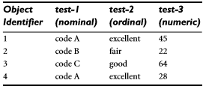



Example1
For table below:
Dissimilarity matrix would be:
Since here we have one nominal attribute, test-1, we set p=1
Using the formula
d(2,1) = 1-0/1 =1, d(3,1)=1-0/1 =1
By calculating all the dissimilarity we will get dissimilarity matrix as:

Slide 34
Example2
id | Type1 | Type2
1 | 10 | A
2 | 30 | B
3 | 10 | A
4 | 20 | C
d(i,j) =p-m/p
d(2,1)=2-0/2=1
d(3,1)=2-2/2=0
d(4,1)=2-0/2=1
d(3,2)=2-0/2=1
d(4,2)=2-0/2=1
d(4,3)=2-0/2=1
0
0
0 1 0
1 1 1 0

Slide 35
Proximity Measure for Nominal Attributes
Alternatively, similarity can be computed as
sim(i, j)=1−d(i, j)=m/p
Method two (encoding scheme): Nominal attributes can be encoded using asymmetric binary attributes by creating a new binary attribute for each of the M states

Slide 36
Proximity measure for binary attributes

Slide 37
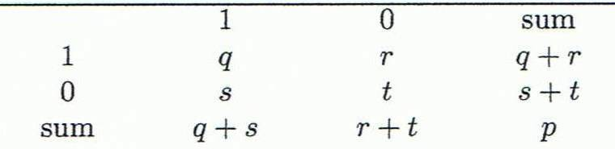
Proximity Measures for Binary Attributes
Binary attributes could be symmetric (ex, gender) or asymmetric (test result of a disease)
Dissimilarity that is based on symmetric binary attributes is called symmetric binary dissimilarity
The dissimilarity based on these attributes is called asymmetric binary dissimilarity
To compute a proximity of binary data we need to compute a dissimilarity matrix from the given binary data
Object j
Object i

Slide 38
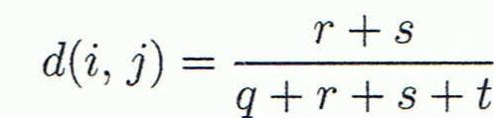
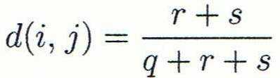



Proximity Measures for Binary Attributes
Symmetric binary dissimilarity
Asymmetric binary dissimilarity
Asymmetric binary similarity between the objects i and j can be computed as

Slide 39
Proximity Measures for Binary Attributes example
Gender is a symmetric attribute
The remaining attributes are asymmetric binary
Let the values Y and P be 1, and the value N is 0
So the dissimilarity can be calculated by :
Object j
Object i

Slide 40
Dissimilarity of numeric attribute

Slide 41
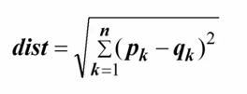
Dissimilarity of Numeric Data
These measures include the Euclidean, Manhattan, and Minkowski distances
The most popular distance measure is Euclidean distance
Where n is number of attributes, and are respectively the kth attributes of data objects p and q

Slide 42
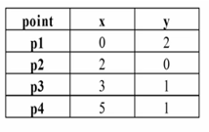
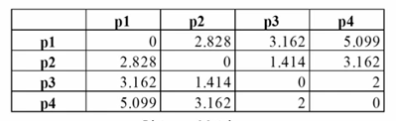
Dissimilarity of Numeric Data
Example for Euclidian distance
What will be the dissimilarity matrix?

Slide 43
Dissimilarity of Numeric Data
Another well-known measure is the Manhattan (or city block) distance
Minkowski distance is a generalization of the Euclidean and Manhattan distances. It is deﬁned as (such distance is also called as Lp norm is some literature)
where h is a real number such that h≥1, it represents the Manhattan distance when h=1 and Euclidean distance when h=2
h → ∞ “supremum” (Lmax norm, L∞ norm) distance
This is the maximum difference between any component (attribute) of the vectors

Slide 44
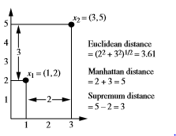
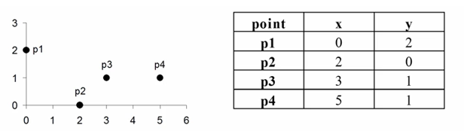
Dissimilarity of Numeric Data
Example 1:
Example 2: What will be the dissimilarity matrix using manhattan and supermum distance?
 | p1 | p2 | p3 | p4
p1 | 0
p2 | 4 | 0
p3 | 4 | 2 | 0
p4 | 6 | 4 | 2 | 0
 | p1 | p2 | p3 | p4
p1 | 0
p2 | 2 | 0
p3 | 3 | 1 | 0
p4 | 5 | 3 | 2 | 0

Slide 45
Dissimilarity of ordinal data

Slide 46
Dissimilarity of Ordinal Data
An ordinal variable can be discrete or continuous
Normalized rank transformation
1.Find Mf
2.Relpace each ordinal data by rank
3.Normalize the ranking

Slide 47

Dissimilarity of Ordinal Data
Example: for the dataset
1)There are three states for test-2: fair, good, and excellent, so Mf =3, so step 1 is to replace each value for test-2 by its rank
four objects are assigned the ranks 3, 1, 2, and 3,
2) normalizes the ranking by mapping
rank 1 to 0.0, rank 2 to 0.5, and rank 3 to 1.0
3) to compute dissimilarity using Euclidian distance

Slide 48
Mixed Data Types

Slide 49
Dissimilarity for Attributes of Mixed Types
A database may contain all attribute types
Nominal, symmetric binary, asymmetric binary, numeric, ordinal
Weighted formula

Slide 50
Dissimilarity for Attributes of Mixed Types Example
Example: Consider the dataset
Here we know the dissimilarity matrix for test1 and test2 which
Now to compute the dissimilarity matrix for test3 we can use Euclidian distance
Test1
Test2
0
0.55 | 0
0.45 | 1 | 0
0.41 | 0.14 | 0.86 | 0

Slide 51


Dissimilarity for Attributes of Mixed Types Example
Now the last step is to compute dissimilarity matrix obtained for the data described by the three attributes of mixed types using
Here is 1 for all attribute
So, lets have d(1,3) = 1(1)+1(0.5)+1(.45)/3 = 0.65
For d(1,2) = 1(1)+1(1.0)+1(0.55)/3 = 0.85
Likewise the final dissimilarity matrix will be
0
0.55 | 0
0.45 | 1 | 0
0.41 | 0.14 | 0.86 | 0

Slide 52
Example
Based on the information given in the table below, find most similar and most dissimilar persons among them. Apply min-max normalization on income to obtain [0,1] range. Consider profession and mother tongue as nominal. Consider native place as ordinal variable with ranking order of [Village, Small Town, Suburban, Metropolitan]. Give equal weight to each attribute.
Name | Income | Profession | Mother tongue | Native Place
Ram | 70000 | Doctor | Bengali | Village
Balram | 50000 | Data Scientist | Hindi | Small Town
Bharat | 60000 | Carpenter | Hindi | Suburban
Kishan | 80000 | Doctor | Bhojpuri | Metropolitan

Slide 53
Solution
After normalizing income and quantifying native place, we get
d(Ram, Balram) = 0.67+1+1+(2-1)/(4-1)=3 d(Ram, Bharat) = 0.33+1+1+(3-1)/(4-1)=3
d(Ram, Kishan) = 0.33+0+1+(4-1)/(4-1) = 2.33 d(Balram, Bharat) = 0.33+1+0+(3-2)/(4-1)=1.67
d(Balram, Kishan) = 1+1+1+(4-2)/(4-1) = 3.67 d(Bharat, Kishan) = 0.67+1+1+(4-3)/(4-1) = 3
Most similar – Balram and Bharat; Most dissimilar – Balram and Kishan
Name | Income | Profession | Mother tongue | Native Place
Ram | 0.67 | Doctor | Bengali | 1
Balram | 0 | Data Scientist | Hindi | 2
Bharat | 0.33 | Carpenter | Hindi | 3
Kishan | 1 | Doctor | Bhojpuri | 4

Slide 54
Cosine Similarity

Slide 55
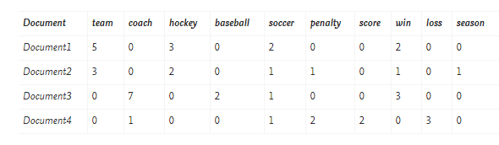
Cosine Similarity (Similarity measure to compare document)
What is cosine similarity?
Application:
information retrieval
biologic taxonomy
recommendation system etc
How it is used in comparison of documents
Eg: Document vector

Slide 56
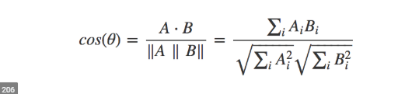
Cosine Similarity (Similarity measure to compare document)
Cosine Similarity:
If A and B are two vectors (e.g., term-frequency vectors), then
Where
indicates vector dot product,
||A||: the length of vector A

Slide 57



Examples
1.Find the similarity between documents 1 and 2
2. Find the similarity between documents 1 and 2.
d₁ = (5, 0, 3, 0, 2, 0, 0, 2, 0, 0)
d₂ = (3, 0, 2, 0, 1, 1, 0, 1, 0, 1)
d₁•d₂ = 5*3+0*0+3*2+0*0+2*1+0*1+0*1+2*1+0*0+0*1 = 25
||d₁||= (5*5+0*0+3*3+0*0+2*2+0*0+0*0+2*2+0*0+0*0)^{0.5}=(42)^{0.5} = 6.481
||d₂||= (3*3+0*0+2*2+0*0+1*1+1*1+0*0+1*1+0*0+1*1)^{0.5}=(17)^{0.5} = 4.12
cos(d₁, d₂ ) = 0.94

Slide 58
Thank you ☺
Q&A
Suggestions / Feedback

